Slide 1

ScholarHomes
By Ryan Shannon & Jomi Kafi

Slide 2
Our Ambition for The Project - Jomi
SchlorHomes project is to revolutionize student accommodation by providing a user-friendly platform that not only simplifies the search process but ensures students have access to safe, affordable, and well-located housing.
Our goal is to alleviate one of the major stresses faced by students today by offering a reliable and efficient tool that aids them in quickly finding their ideal home close to their educational institutions.

Slide 3

Our Solution - jomi
Student-Centric Housing Solutions: SchlorHomes is dedicated to helping students find the best and most affordable accommodation options near their educational institutions.
Optimized Search Features: The app provides tailored search functionalities that enable students to filter and select housing based on their specific needs and budget.
Accessibility and Affordability: Focused on affordability, SchlorHomes ensures that the housing options available are within the financial reach of students, making it easier to secure convenient and cost-effective living spaces.

Slide 4
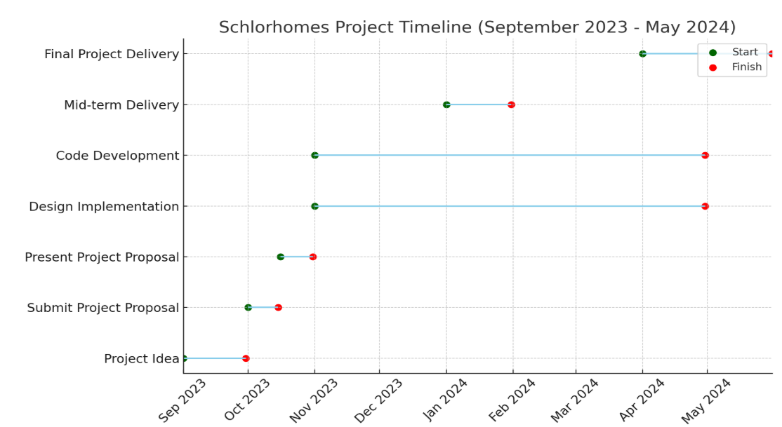
Project Timeline (e.g. Gantt) - Jomi

Slide 5

Primary Research - Ryan
We conducted primary research by asking 9 university students who have previously lived in student accommodation about their experiences
6 out of 9 faced difficulty securing accommodation
We interviewed both Irish and International students such Gemma
Gemma was one of several students who stated they had a fear of living with a stranger

Slide 6
Secondary Research - Ryan
There is a clear lack of student accommodation in Ireland:
Protests about the lack of student accommodation (4th of October 2023, 300 students participants)
The average rent in Ireland surpasses the peak of the Celtic Tiger era by more than 50%

Slide 7

Market - Ryan Information gotten from HEA.ie
Main Demographic Students aged 18 – 30
Customer Channel Social Media, Student organizations, Online advertisements
Target Market Made up of 202,100 (demand – current accommodation available)

Slide 8
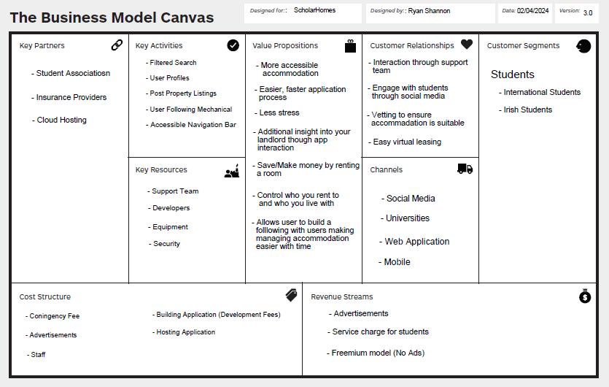
BMC - Ryan
Potential Revenue
Advertisements
Service Charge
Freemium model
Potential Cost
Marketing
Staff
Development
Contingency
Cloud hosting fee

Slide 9
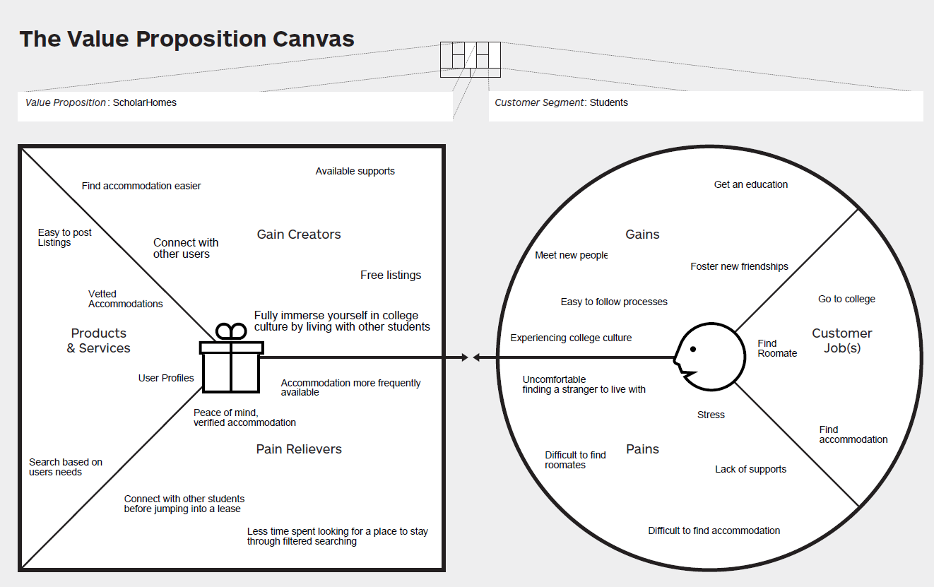
VPC – jomi

Slide 10



Competitor Analysis - Jomi
s
 | DCUaccommodation | Daft.ie | Rent.ie | ScholarHomes
Accessibility |  |  |  | X
Long-Term viability | X | X |  | X
Chat features |  | X |  | X
Personal user profiles |  |  | X | X
Free Listings | X |  |  | X
Mobile compatibility |  |  | X | X

Slide 11
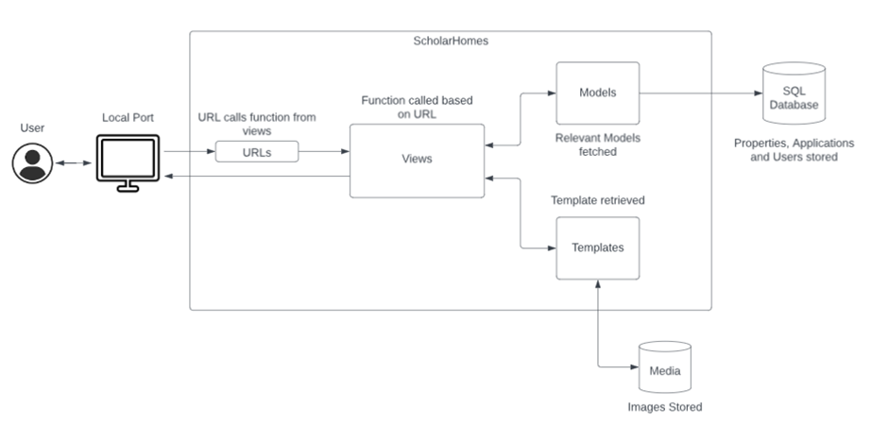
Django Framework - Ryan
We utilized the Django framework to create the application
Frontend
Html
CSS
Backend
Python
Java

Slide 12
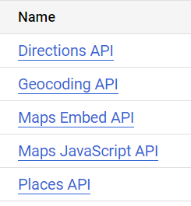
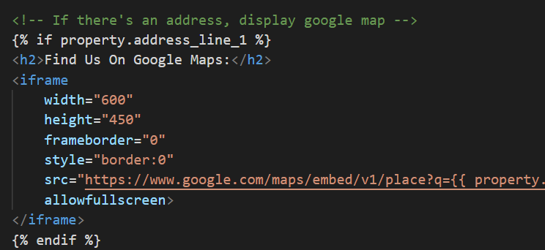
External Interfaces - Ryan
Summary The google map API allows ScholarHomes to display an embedded google map into our web page from an address
Requirements
In order to use this API, we must first enable the APIs we wish to use on Google cloud and then create an API key

Slide 13
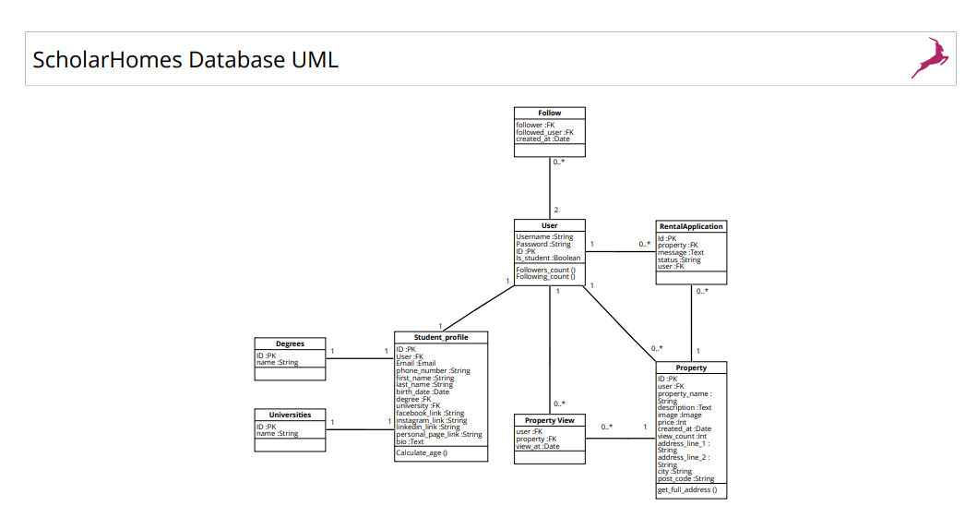
Database Design - Ryan

Slide 14
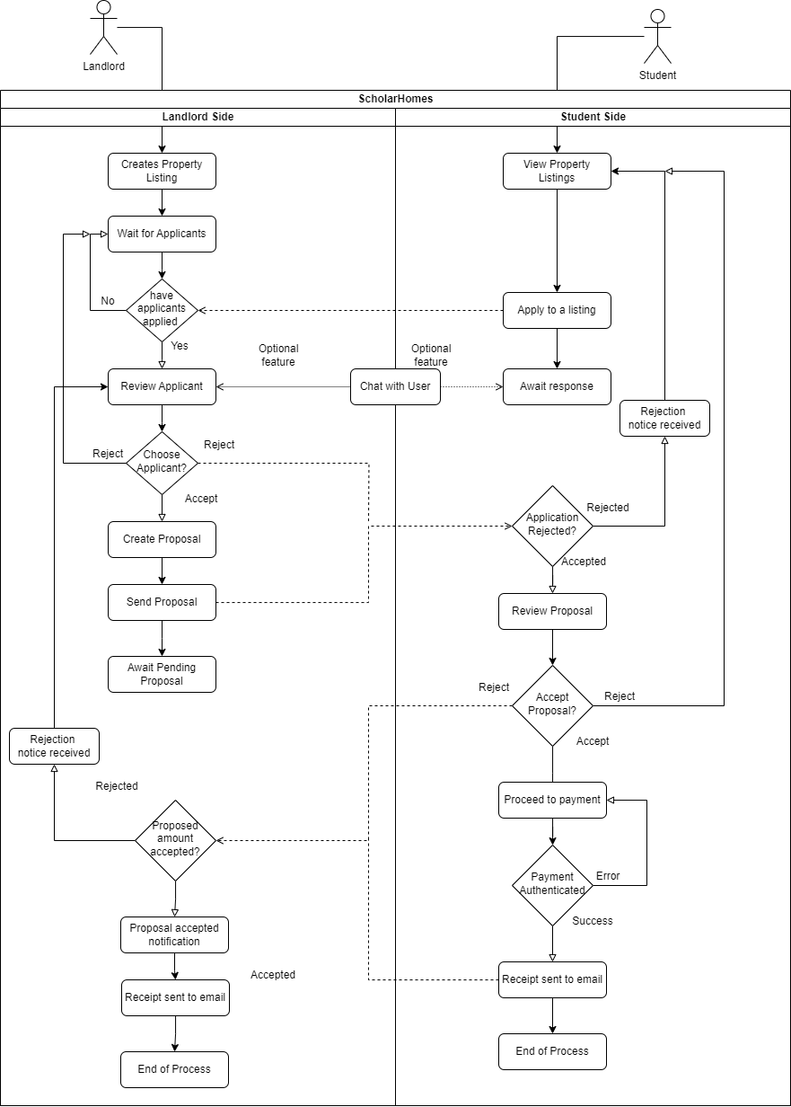
BPMN Process we're trying to create - Ryan
Lister: Create a listing
Seeker: View property listings
Seeker: Apply to listing
Lister: Look through potential applicants
Lister: Accept and notify client

Slide 15
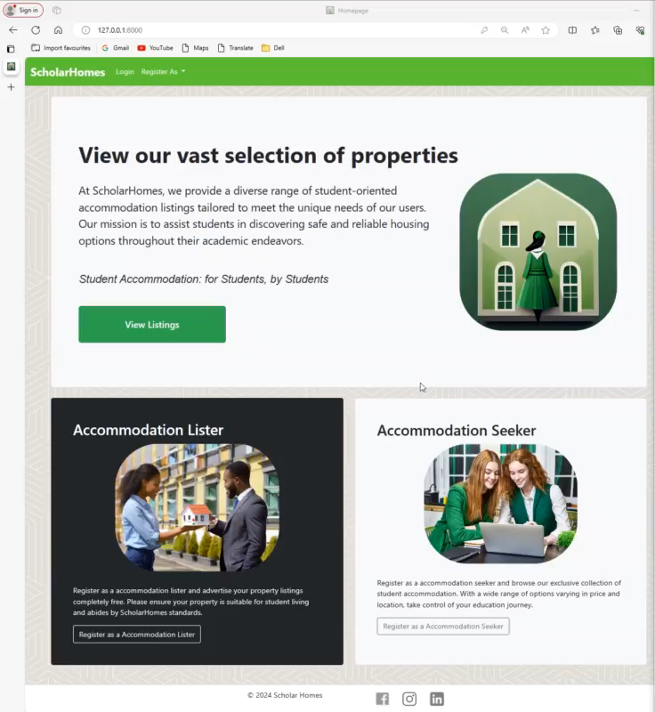
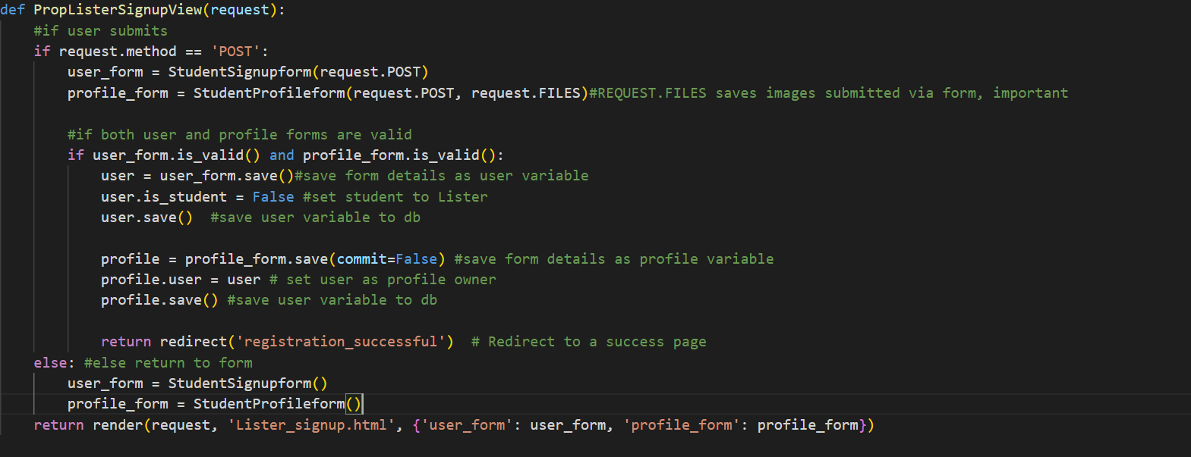
Registering Student - Ryan

Slide 16
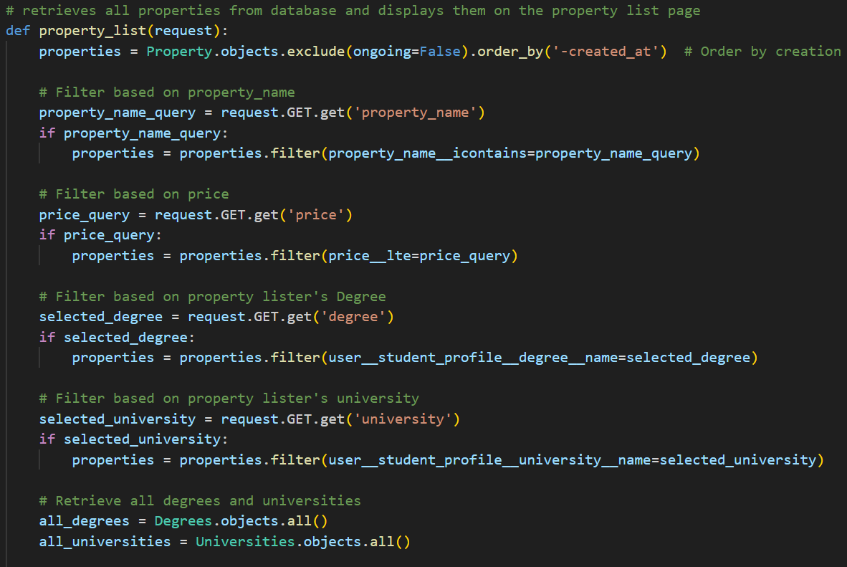
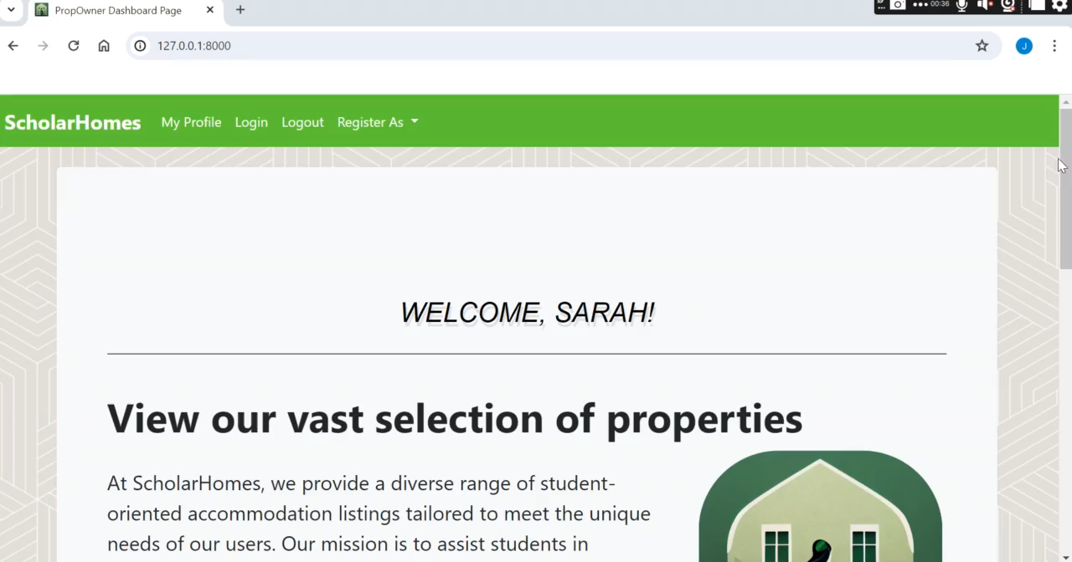
View Properties – Jomi

Slide 17
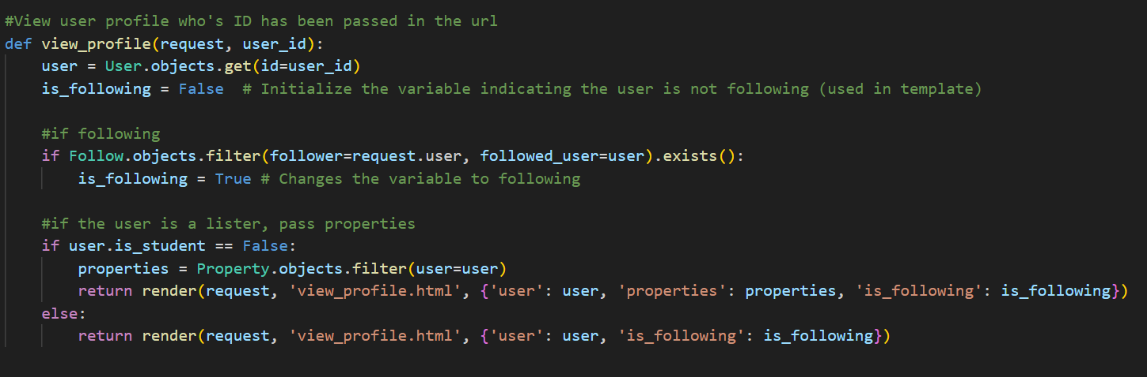
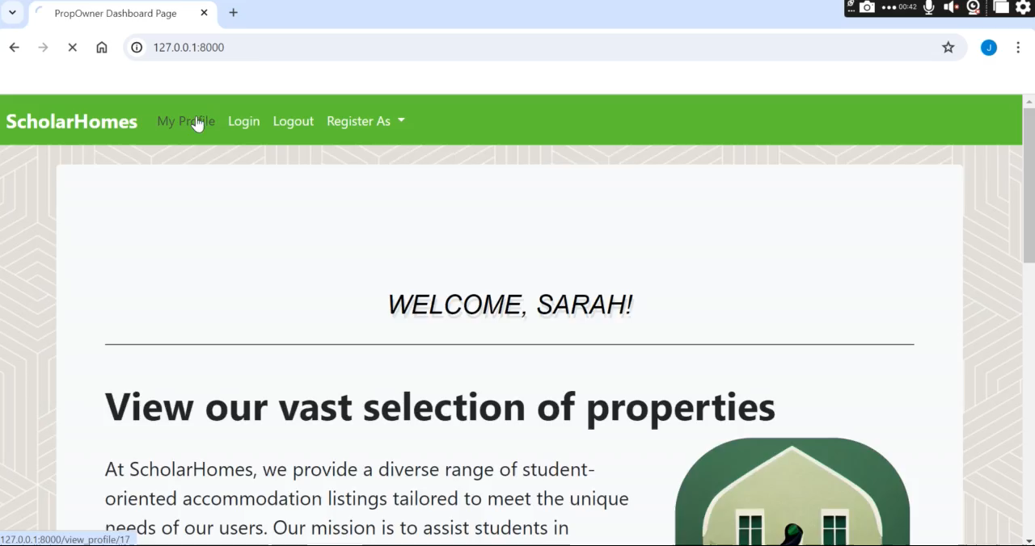
View Profile - jomi

Slide 18
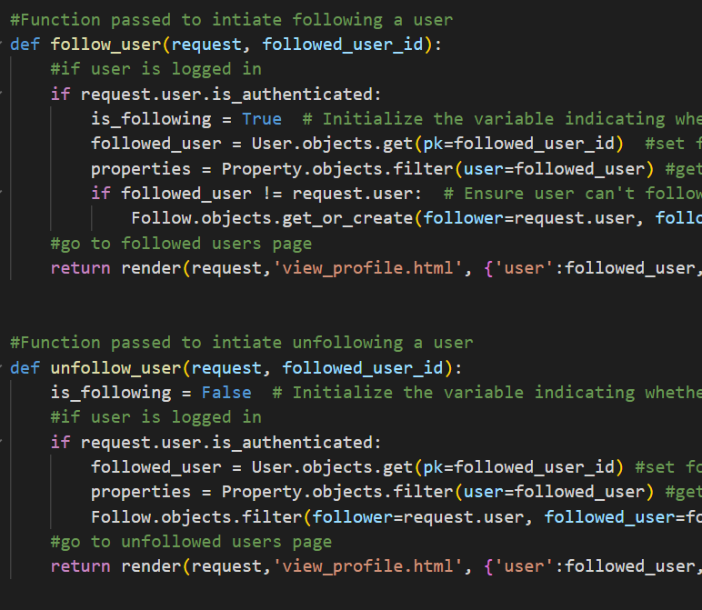
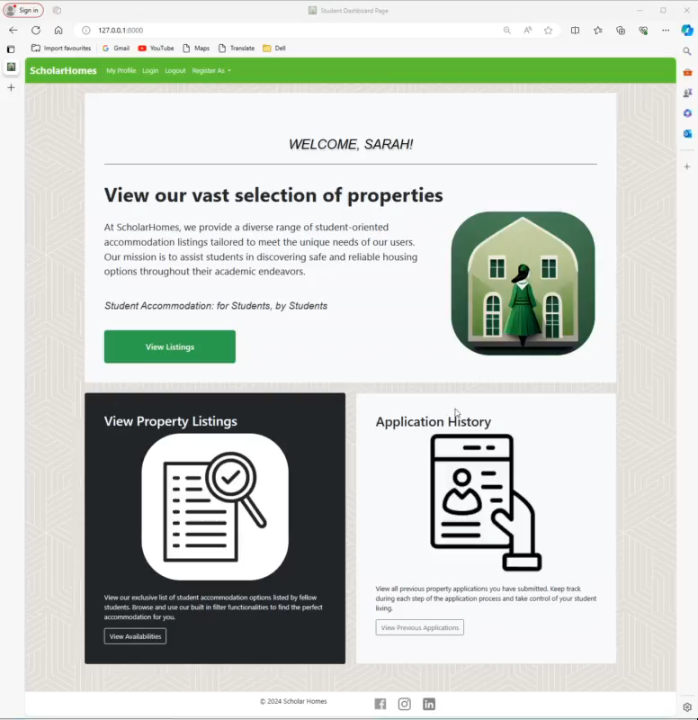
Following/Follower - Ryan

Slide 19
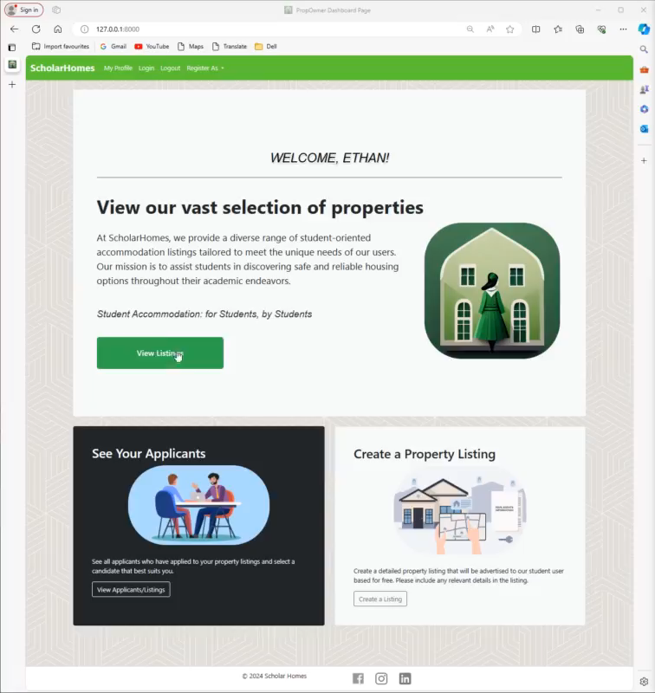
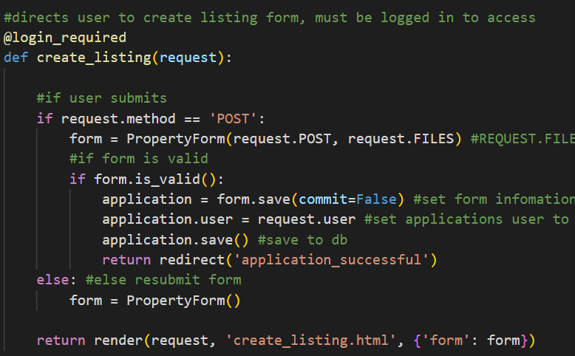
Creating a Listing - Ryan

Slide 20
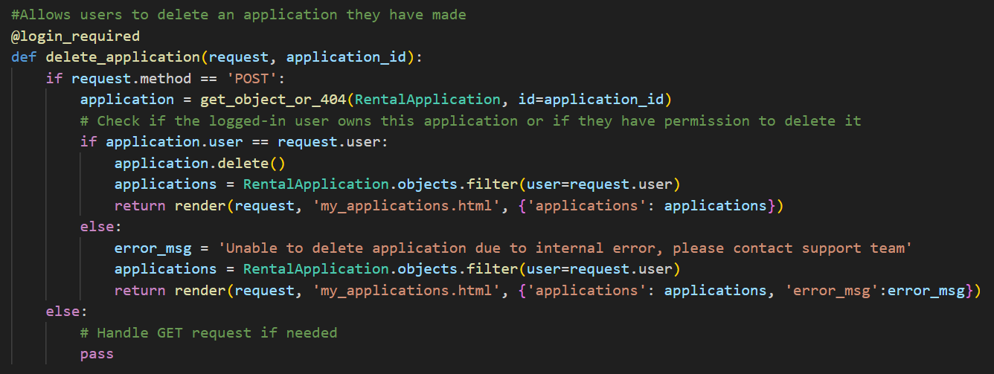
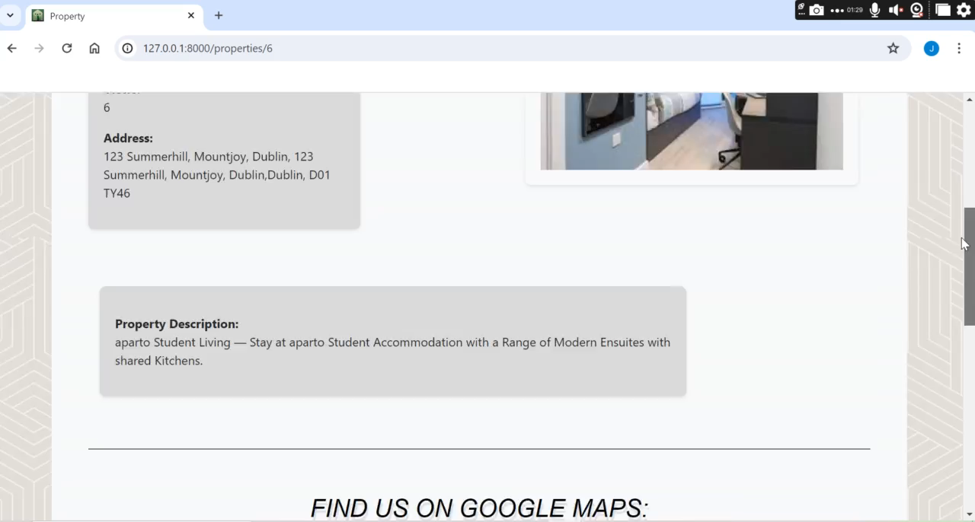
Apply to Listing (View/Delete listings) - Jomi

Slide 21
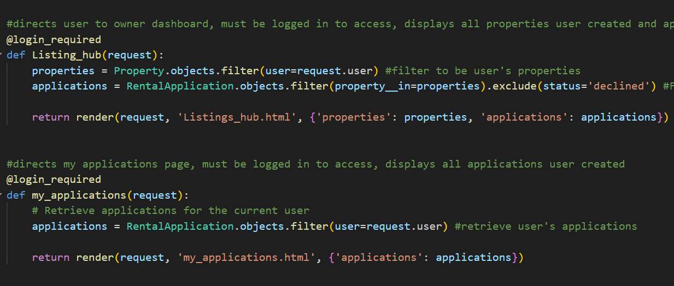
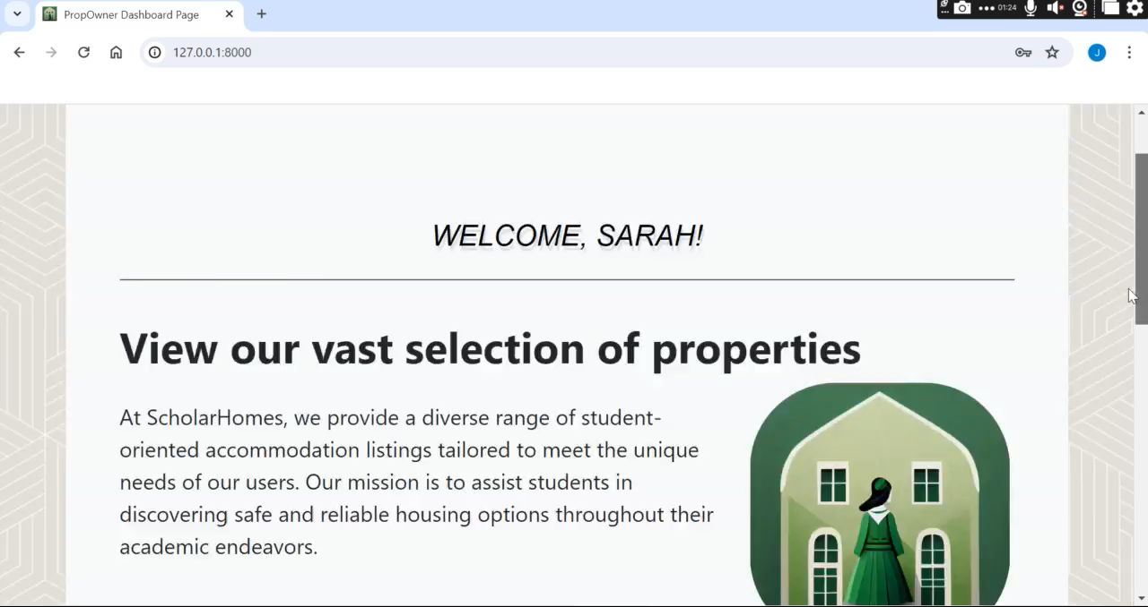
View my Listings and Applications - Jomi

Slide 22
Future Features - Jomi
Roommate Matching
Virtual Tours
Rating and Review System
Real-time Notifications

Slide 23

The Future Goals and Objectives - Jomi
Partnerships with Universities: Form partnerships with institutions to become their go-to resource for housing searches. This will make it easy for students to find safe housing.
Sustainability Initiatives: Support ways of living that are good for the earth and work with companies that provide eco-friendly housing to provide sustainable lodging.
Make a Community Platform: Create a community within the app so that students can talk about housing, share their experiences, and give each other tips, creating a helpful network.
Regular changes and New Features: Commit to regular changes and adding new features that meet changing user needs and take advantage of new technology.

